Slide 1

Data Analyst Jobs in the UK
Using NLP to Predict High vs. Low Paying Jobs
By: Seye Sij - Ironhack 2023

Slide 2
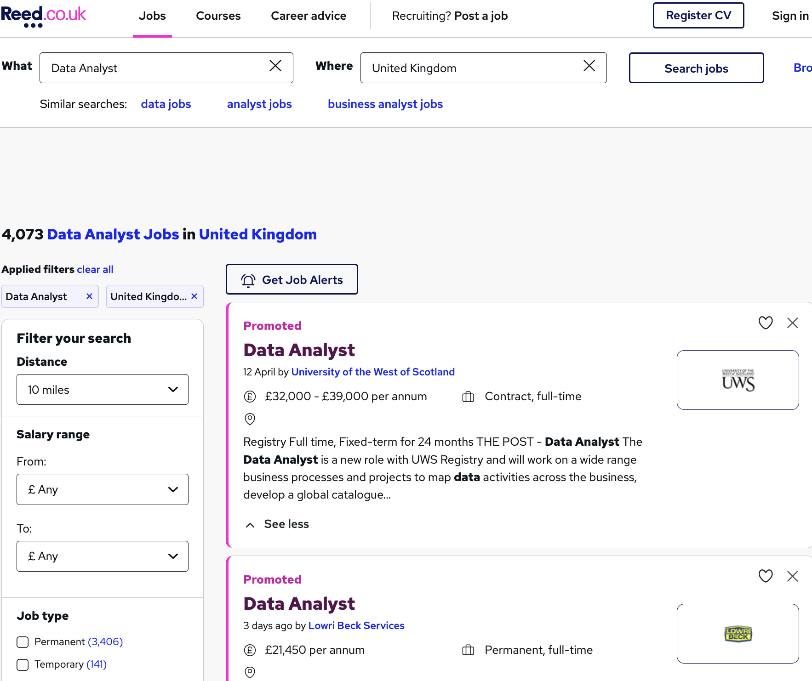
Data Collection
Web Scraping reed.co.uk

Slide 3
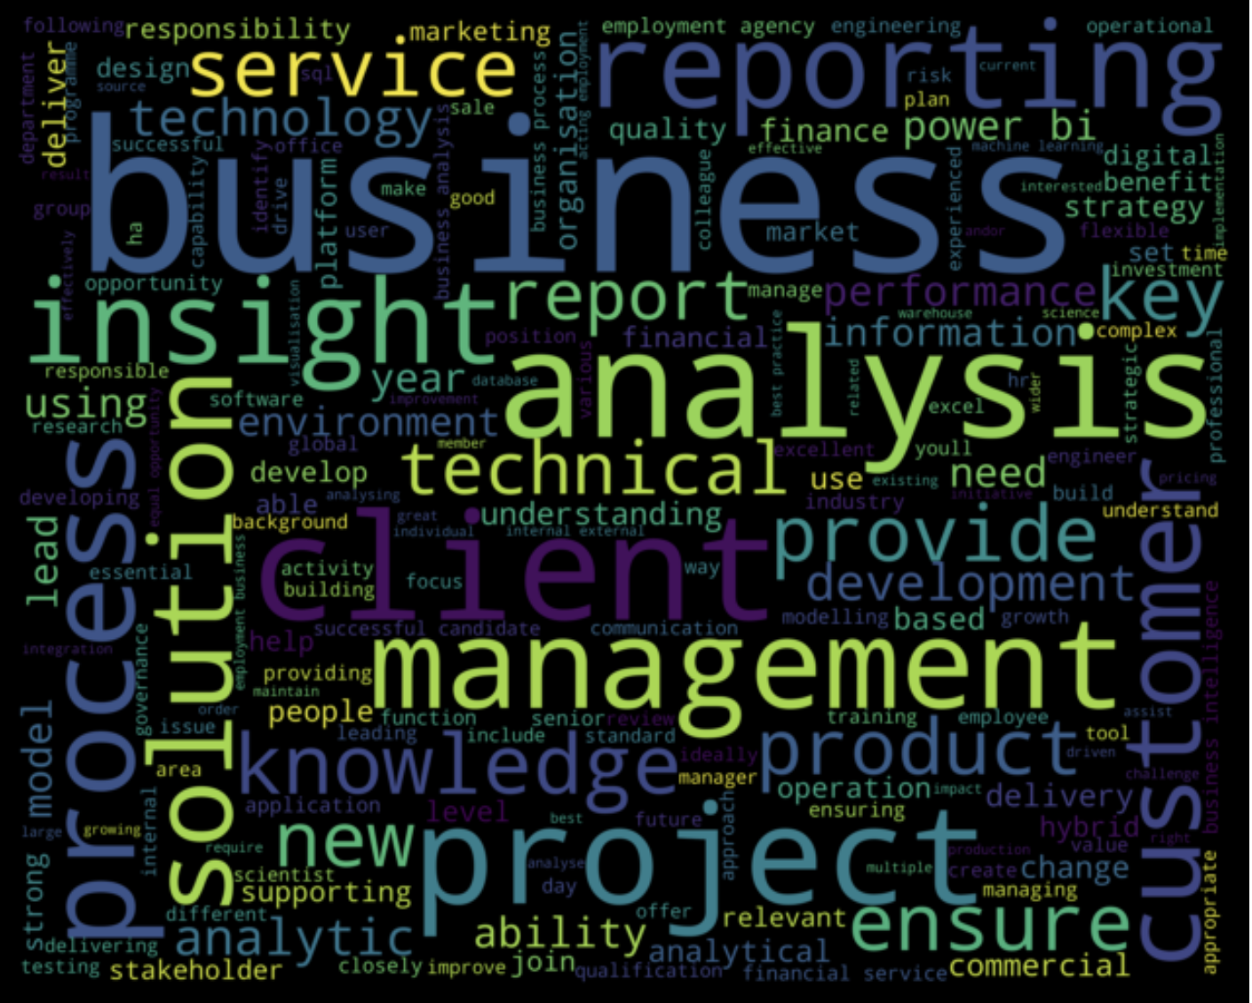
Data Jobs Word Cloud
Notes:
What exactly is a word cloud ?
A word cloud is a visualization technique for text data where the most frequent word is shown in the biggest font size.

Slide 4
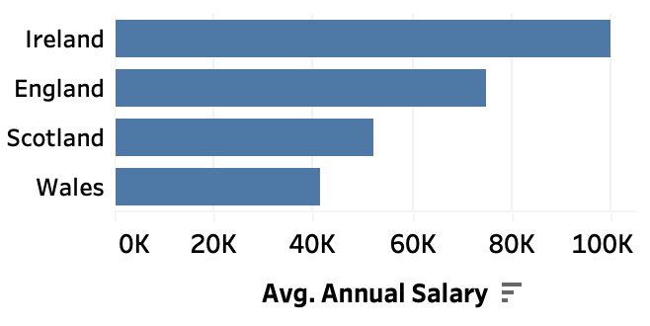
Average Salary in UK Regions

Slide 5
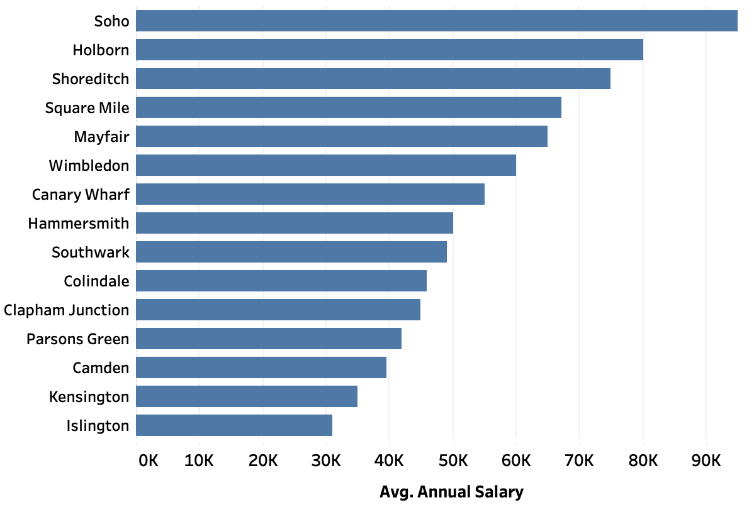
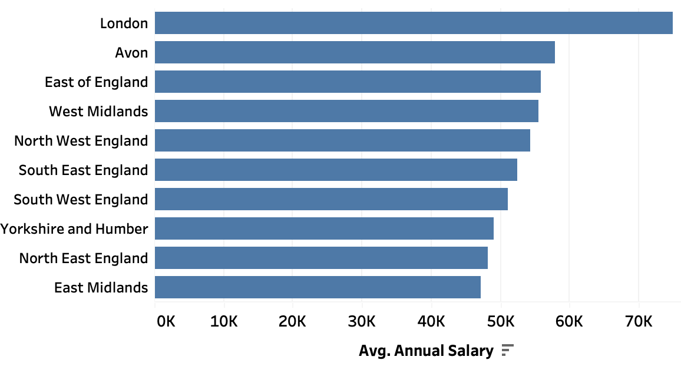
Average Salary in English Regions
Average Salary in London Boroughs
Figure 1
Figure 2

Slide 6
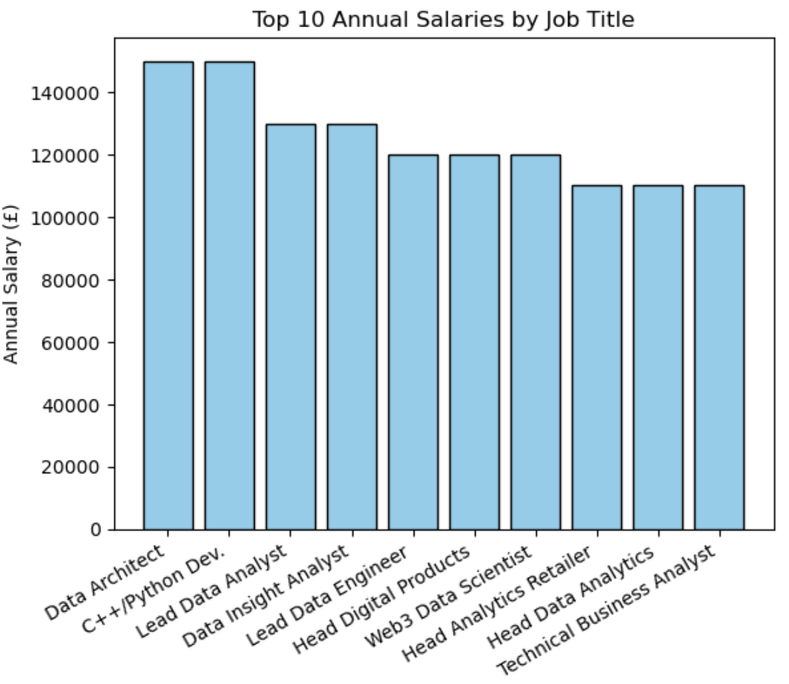

Slide 7
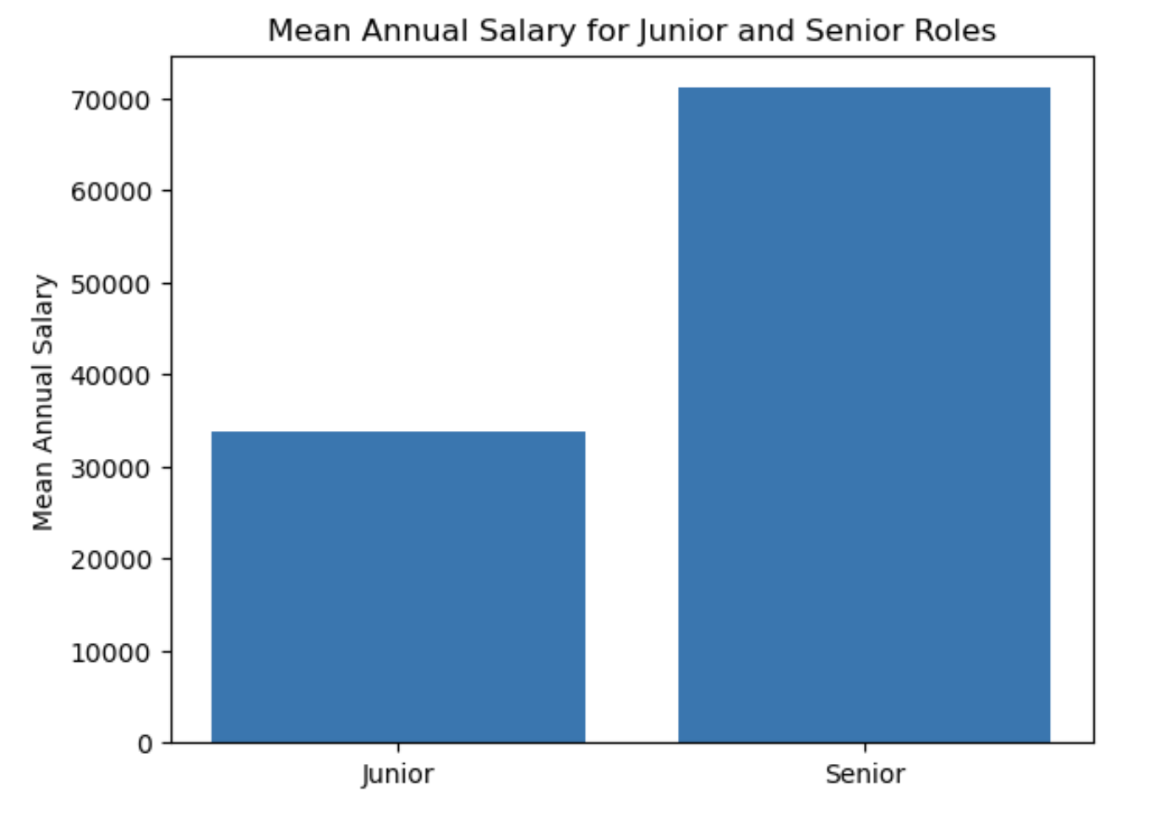
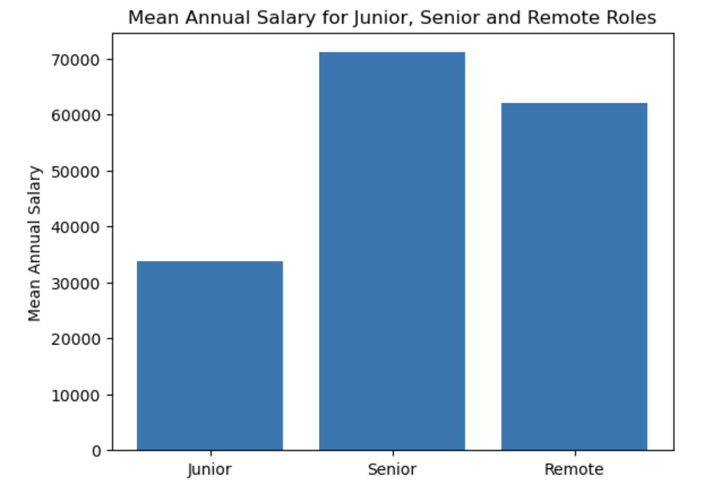
Figure 1
Figure 2

Slide 8
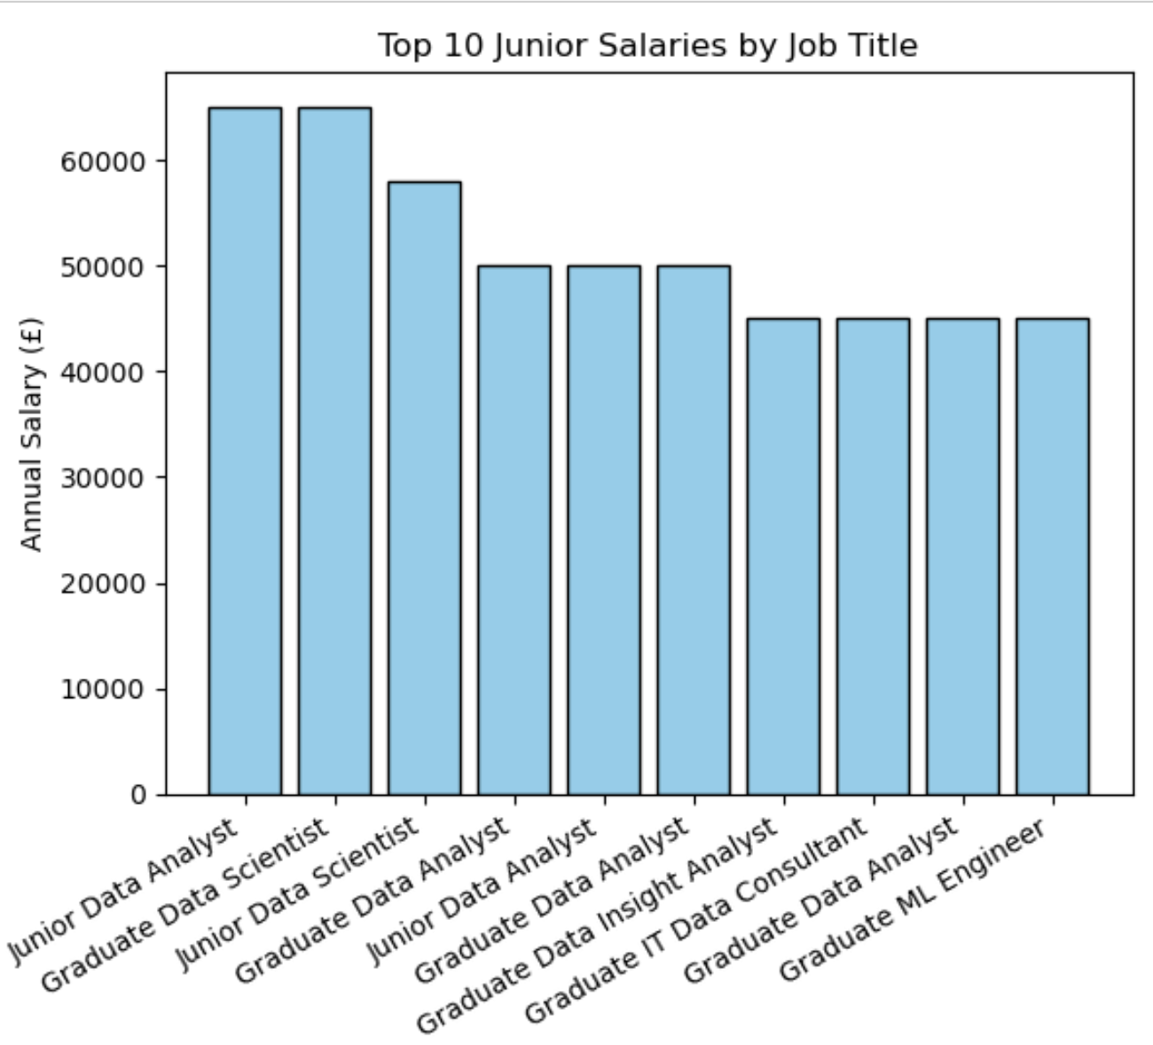
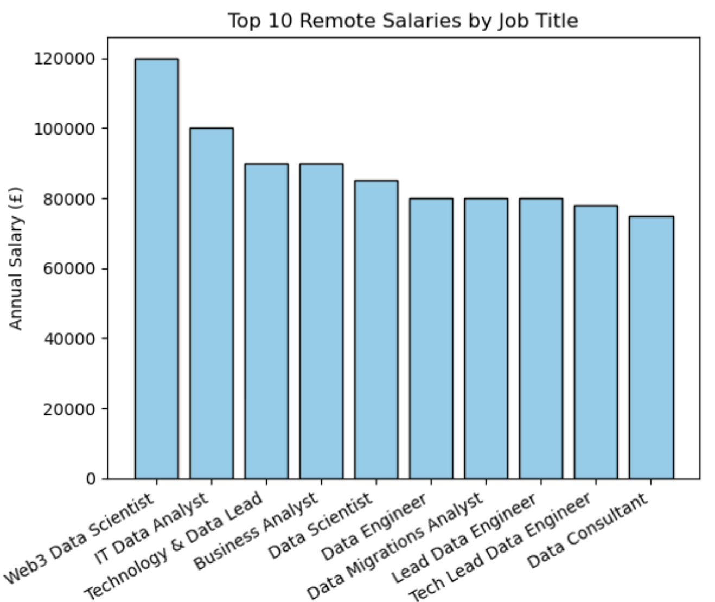
Figure 1
Figure 2

Slide 9
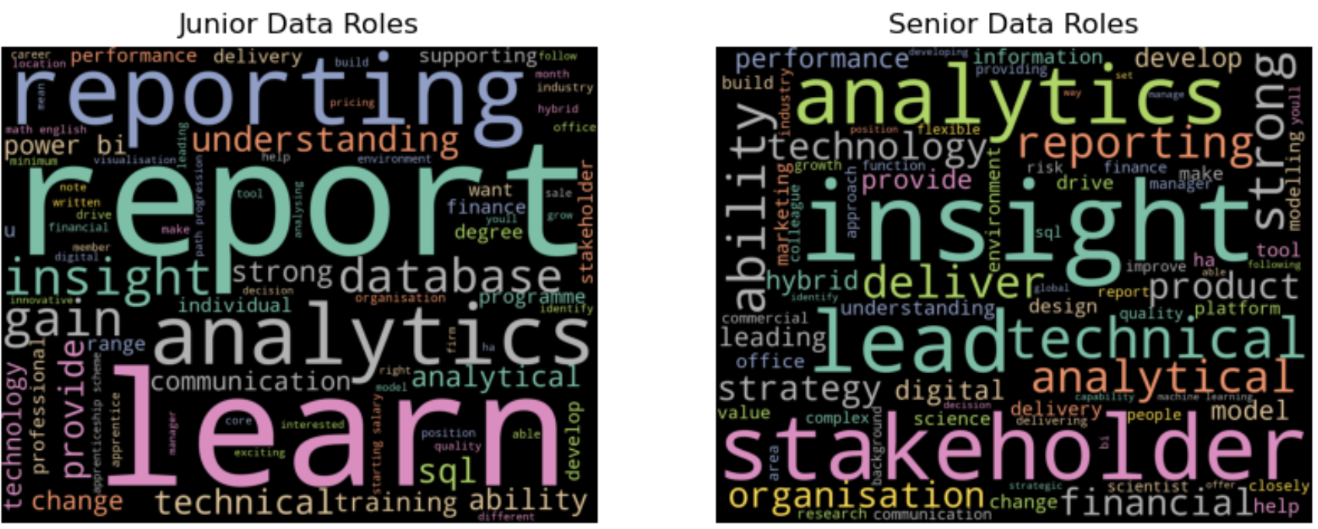
Job Description Word Cloud for Junior and Senior Roles

Slide 10
Modeling – Text Classification
Model the relationship between the job description and the target variable high(1) or low(0) salary
Use of CountVectorizer to convert text data into a matrix of token counts
Use token counts as input to train a machine learning model for text classification
Model 1: Multinomial Naive Bayes
Model Accuracy: 0.7
Model 2: Logistic Regression
Model Accuracy: 0.8
Notes:
This is a text classification problem with two classes, high (1) and low (0). The task involves predicting the class label (high or low) based on the text data (job description). In this case, we are using the text data as input features to make the binary classification prediction.
Logistic Regression: This is a linear model that works well for binary classification problems. It can be used to model the relationship between the job description and the target variable (high/low salary).
Multinomial Naive Bayes : works well for text classification problems

Slide 11
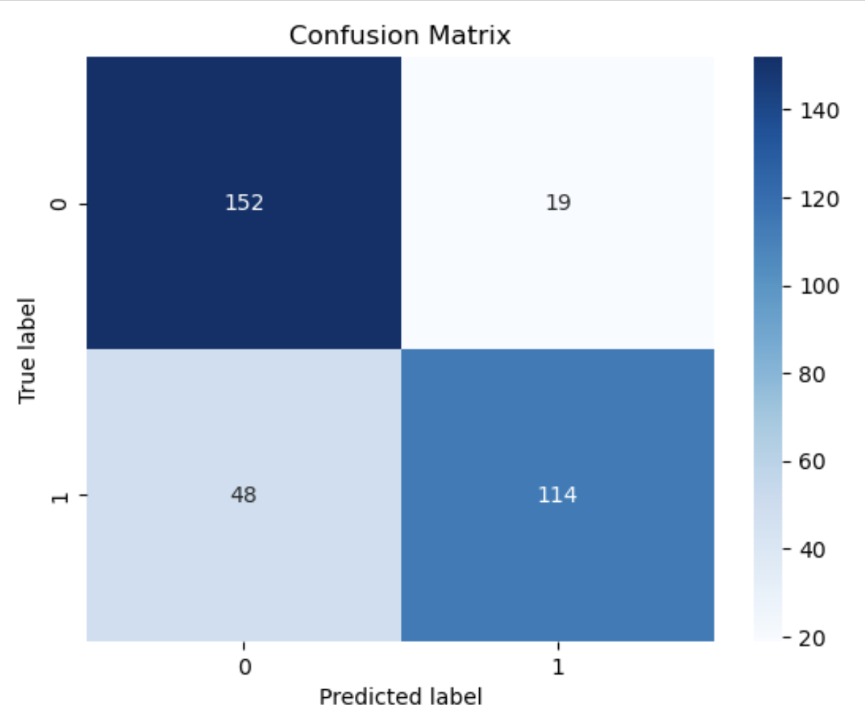
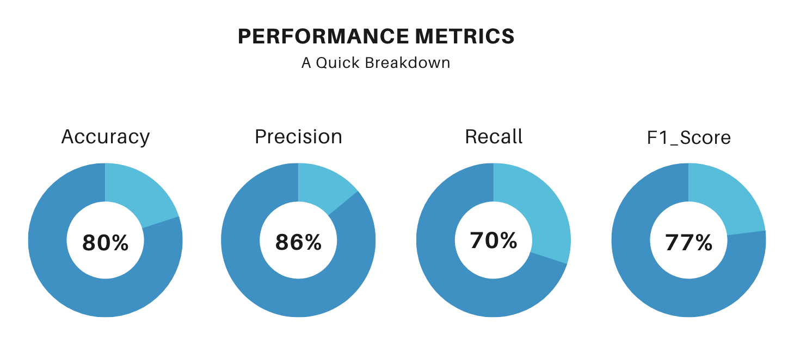
Model Evaluation – Logistic Regression High vs low salary

Slide 12


A mini job search portal
THE END Good luck with job searching!

